Slide 1
MODULE 5 – INTRODUCTION TO PERIPHERAL INTERFACING - iI
Dr. P. Nirmala
Assistant Professor, Sr. Gr. I,
SENSE,
VIT Chennai Campus.

Slide 2
Interfacing digital to analog converters
DACs convert binary numbers into their analog equivalent voltages
Applications of DAC
Digitally controlled gains
Motor speed controls
Programmable gain amplifiers

Slide 3
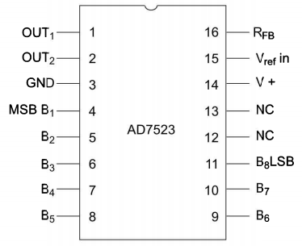
AD 7523 8-bit multiplying dac
Intersil’s AD 7523 is a 16 pin, multiplying DAC containing R-2R ladder with R=10 K for digital to analog conversion along with single pole double throw NMOS switches to connect the digital inputs to the ladder.

Slide 4
continued
The supply range extends from +5V to +15V
The maximum analog output value is +10V, when all the digital input values are at logic high state
To save the DAC from negative transients, a Zener diode is connected between OUT1 and OUT2.
An OPAMP is used as a current-to-voltage converter at the output of AD 7523 in order to generate an equivalent output voltage for the current produced.

Slide 5
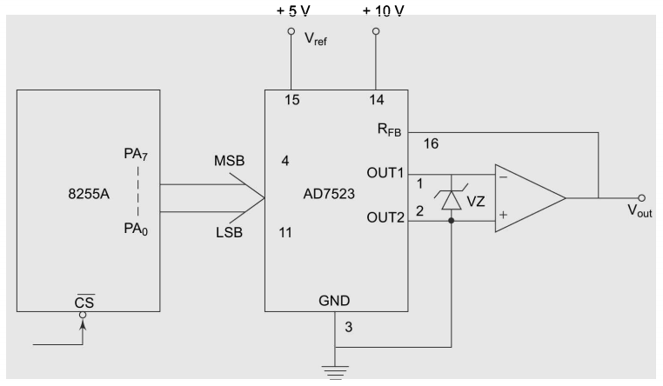
Example problem to interface dac with 8086

Slide 6
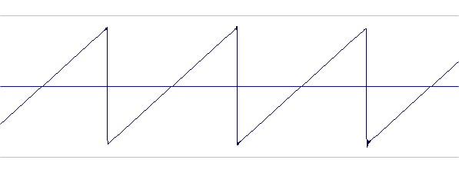
Sawtooth wave

Slide 7

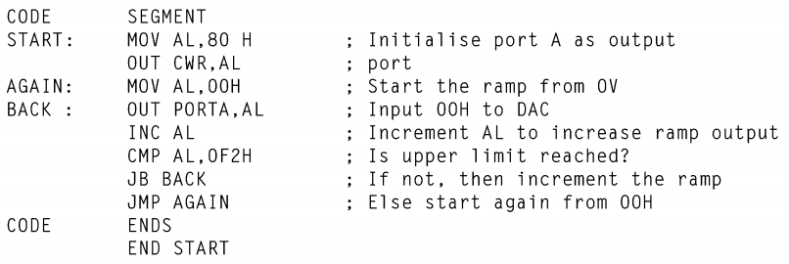
Port A is designed to send the digital data as inputs to the converter
The ramp starts from 0V and hence AL is moved with 00H.
To increment the ramp, the value of AL must be incremented till it reaches FFH
After that the sawtooth again starts from 00H and this procedure repeats

Slide 8
Dac 0800 8-bit digital to analog converter
DAC 0800 is a monolithic 8-bit DAC manufactured by National Semiconductor.
It can work at various voltages from 4.8V to 18V, usually, 5V or 12 V

Slide 9
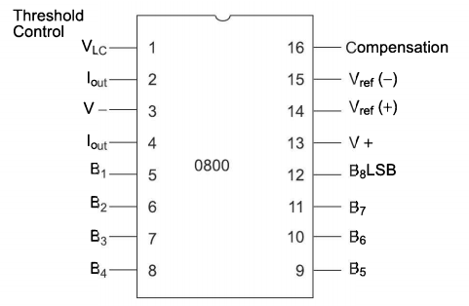
Pin diagram

Slide 10
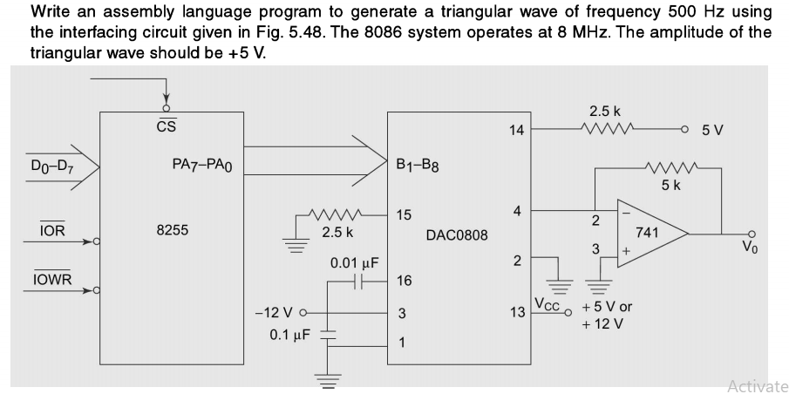
example

Slide 11
Triangular wave

Slide 12
